Slide 1
"Always code as if the guy who ends up maintaining your code will be a violent psychopath who knows where you live."
Martin Golding.

Slide 2

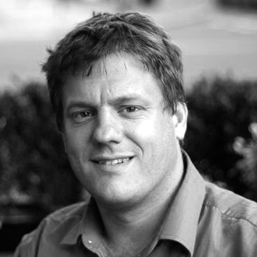
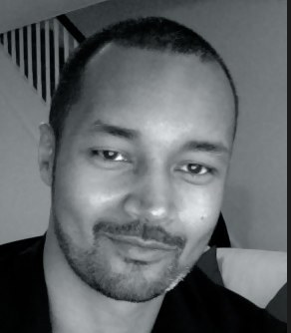
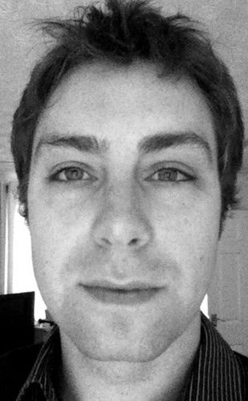
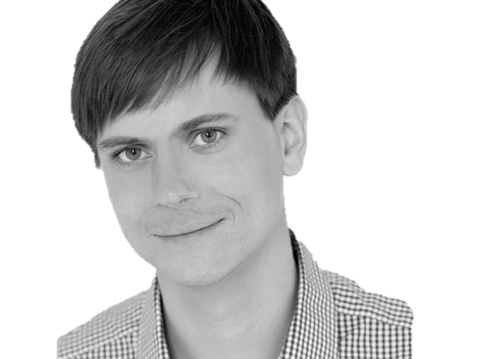

@riverglide
@andypalmer
@antonymarcano
@jmrtn
@pro_cessor

Slide 3

Ψ

Slide 4
Informatik
Keine Naturwissenschaft

Slide 5
Einstellungsähnlichkeit korreliert positiv mit DER interpersonellen Anziehung

Slide 6
Gleich und Gleich Einstellungsähnlichkeit korreliert positiv mit DER interpersonellen Anziehung gesellt sich gern

Slide 7
Die gravitationsbedingte vertikale Dislokation maliformer Agrarprodukte aus der Position ihrer Bio-Genese erfolgt in der Regel proxitrunkial

Slide 8

Der APFEL Fällt nicht Die gravitationsbedingte vertikale Dislokation maliformer Agrarprodukte aus der Position ihrer Bio-Genese erfolgt in der Regel proxitrunkial weit vom stamm

Slide 9
M a s c h i n e
Wir schreiben für die
anstatt für uns.

Slide 10
S
Open – Closed Principle
Liskov Substitution Principle
Interface Segregation Principle
Dependency Inversion Principle

Slide 11
S
O
Liskov Substitution Principle
Interface Segregation Principle
Dependency Inversion Principle

Slide 12
S
O
L
Interface Segregation Principle
Dependency Inversion Principle

Slide 13
S
O
L
I
Dependency Inversion Principle

Slide 14
S
O
L
I
D

Slide 15
S
O
L
I
D

Slide 16
S
O
L
I
D
Release-Reuse Equivalency Principle
Common Reuse Principle
Common Closure Principle
Acyclic Dependency Principle
Stable Abstractions Principle
Stable Dependencies Principle

Slide 17
S
O
L
I
D
RR
Common Reuse Principle
Common Closure Principle
Acyclic Dependency Principle
Stable Abstractions Principle
Stable Dependencies Principle

Slide 18
S
O
L
I
D
RR
CR
Common Closure Principle
Acyclic Dependency Principle
Stable Abstractions Principle
Stable Dependencies Principle

Slide 19
S
O
L
I
D
RR
CR
CC
Acyclic Dependency Principle
Stable Abstractions Principle
Stable Dependencies Principle

Slide 20
S
O
L
I
D
RR
CR
CC
AD
Stable Abstractions Principle
Stable Dependencies Principle

Slide 21
S
O
L
I
D
RR
CR
CC
AD
SA
Stable Dependencies Principle

Slide 22
S
O
L
I
D
RR
CR
CC
AD
SA
SD

Slide 23
S
O
L
I
D
RR
CR
CC
AD
SA
SD
Tell, don‘t ask
DRY
KISS
YAGNI

Slide 24
S
O
L
I
D
RR
CR
CC
AD
SA
SD
Tell, don‘t ask
DRY
KISS
YAGNI

Slide 25
S
O
L
I
D
RR
CR
CC
AD
SA
SD
Tell, don‘t ask
DRY
KISS
YAGNI

Slide 26
S
O
L
I
D
RR
CR
CC
AD
SA
SD
Tell, don‘t ask
DRY
KISS
YAGNI

Slide 27
S
O
L
I
D
RR
CR
CC
AD
SA
SD
Tell, don‘t ask
DRY
KISS
YAGNI

Slide 28
Separation
Machine
Domain
??

Slide 29
Empathie
Von Person zu Person

Slide 30
Empathy is the capacity to think and feel oneself into the inner life of another person
Heinz Kohut Psychoanalyst

Slide 31
Haltet EIN
Da kommt noch mehr!

Slide 32
Simple First
Paradigm-Commitment
Abstraction Seggregation
Domain Relationship
Listening and Learning
Languages
Binary Dependency
Domain Language
Shared Under-standing
Eloquence
Patterns aren’t solutions
Weasel Word Removal

Slide 33
Simple First
Paradigm-Commitment
Abstraction Seggregation
Domain Relationship
Listening and Learning
Languages
Binary Dependency
Domain Language
Shared Under-standing
Eloquence
Patterns aren’t solutions
Weasel Word Removal

Slide 34
Erst mal einfach
Simple First!
Richtig schwer!

Slide 35
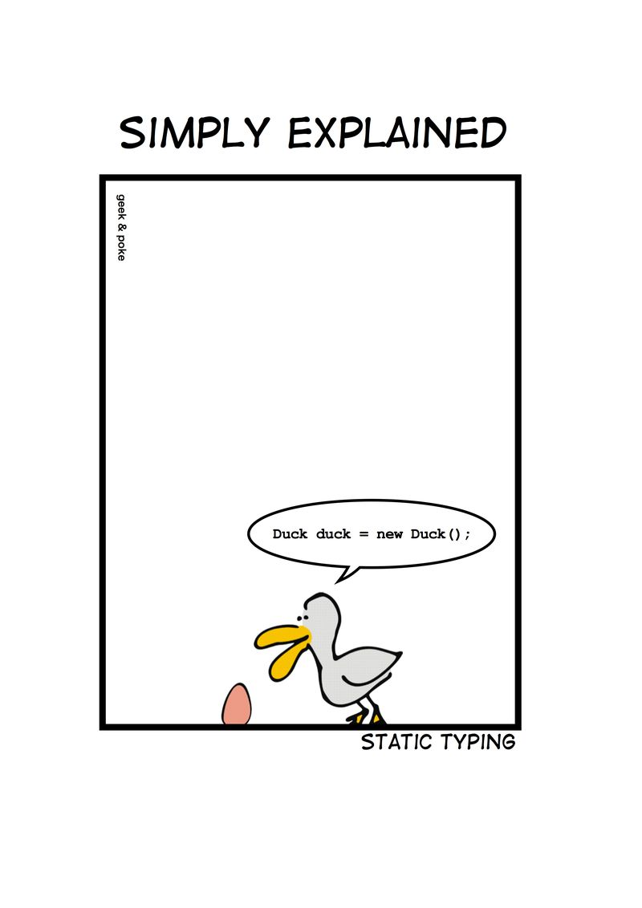

Slide 36
C# Duck duck = new Duck();

Slide 37
Python duck = Duck()

Slide 38
C# - DRY var duck = new Duck();

Slide 39
Zug.un.glück
Es steht ein
bevor

Slide 40
Don’t ASK
Tell.
Or: The Law of Demeter

Slide 41
if(Customer.Email.Address.Value.IsValid) { Send(Customer.Email.Address, message); }

Slide 42
if(Customer.IsEmailValid()) { Send(Customer.Email.Address, message); }

Slide 43
Customer.Send(message)

Slide 44
Message.SendTo(Customer)

Slide 45
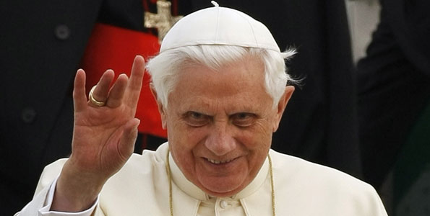
Don’t let a stranger touch your privates

Slide 46
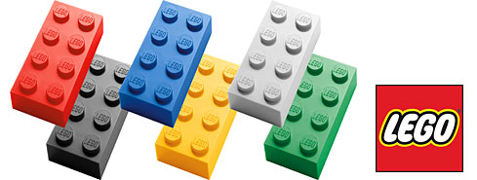
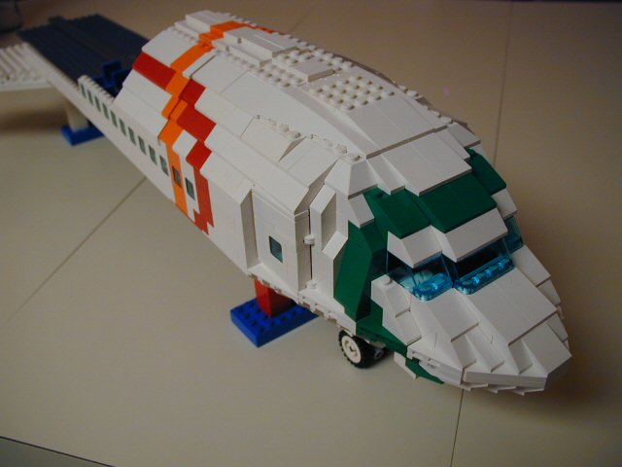
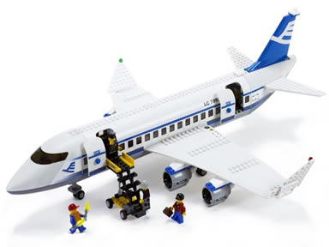
Size & Reuse

Slide 47
überraschungen
Keine
Was erwartest du?

Slide 48
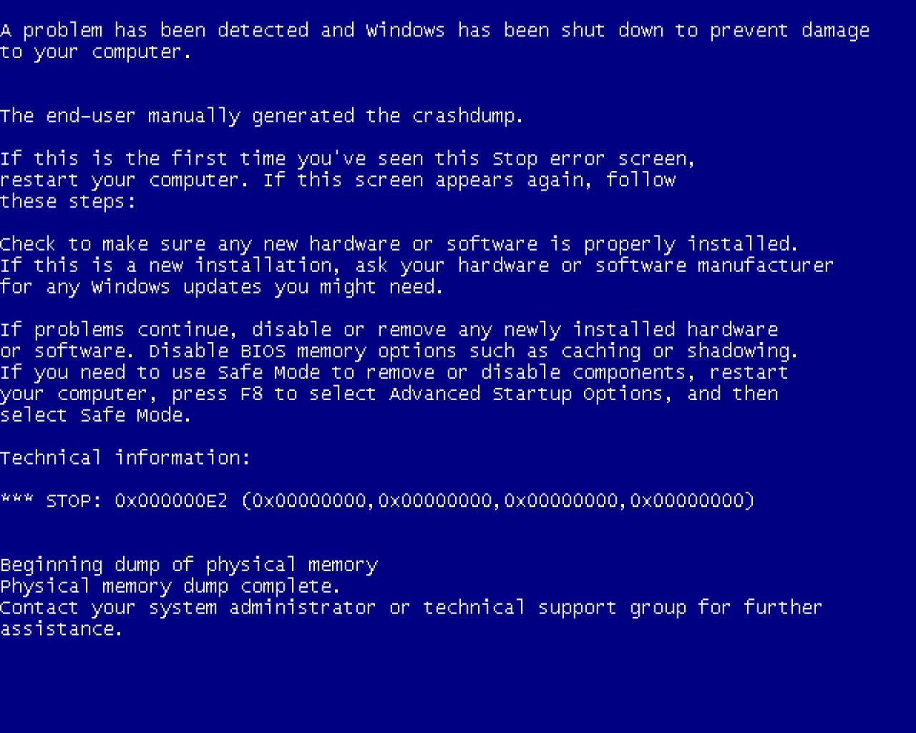
Notes:
Diese Folie ist ein Nullobjekt

Slide 49
Notes:
Diese Folie ist ein Nullobjekt

Slide 50
NullObjekte

Slide 51
Spüre deinen Code
Man sieht nur mit dem Herzen gut

Slide 52
public void Execute(MainViewModel mainViewModel) { mainViewModel.Done = () => Break(mainViewModel); mainViewModel.StartCounter(); } public void Break(MainViewModel model) { model.Color = 0x00DBFF.Rgb().Brush(); model.TimeLeft = 5.Minutes(); model.Done = () => Work(model); model.StartCounter(); } public void Work(MainViewModel model) { model.Color = 0x00DB00.Rgb().Brush(); model.TimeLeft = 25.Minutes(); model.Done = () => Break(model); model.StartCounter(); }

Slide 53
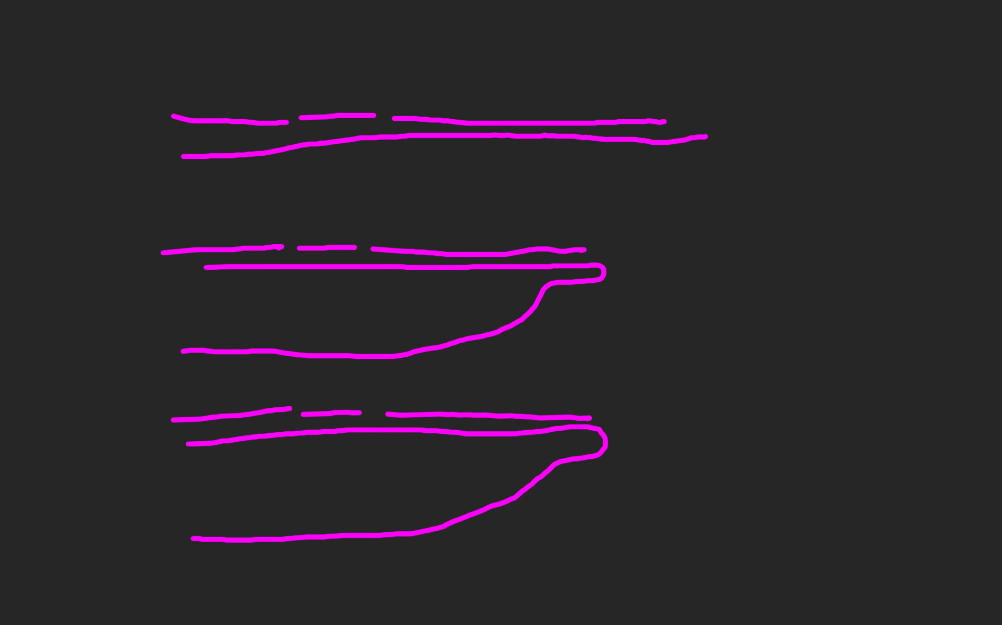
public void Execute(MainViewModel mainViewModel) { mainViewModel.Done = () => Break(mainViewModel); mainViewModel.StartCounter(); } public void Break(MainViewModel model) { model.Color = 0x00DBFF.Rgb().Brush(); model.TimeLeft = 5.Minutes(); model.Done = () => Work(model); model.StartCounter(); } public void Work(MainViewModel model) { model.Color = 0x00DB00.Rgb().Brush(); model.TimeLeft = 25.Minutes(); model.Done = () => Break(model); model.StartCounter(); }

Slide 58
def filter(markup): return add_twitter_names(markup) def add_twitter_names(markup): pattern = "@(\w+)" url = "https://twitter.com/" link = "<a href='%s\\1'>@\\1</a>" % url replacement = link return re.sub(pattern, replacement, markup) def home(entries): markup = create_page(entries) markup = filter(markup) return markup def main(): entries = Entries() if len(argv) > 1: date = argv[1] entries = entries.written_on(date) print home(entries)

Slide 59
metrik
Die einfachste
für die C-Familie

Slide 60
Signature Survey Datei (<loc>): { ; }

Slide 61
ExitWindowsFlags.cs (17): ;{{}} FullScreen.cs (10): {{{;}}} HexToColorExtension.cs (30): ;{{{;}{;}{;}}} Hibernate.cs (23): ;{{{}{}{;;;;}}} ICanBeSelected.cs (10): ;;{{;}} ICanStartAndStop.cs (12): ;{{{;;};;}} IExecute.cs (10): ;;{{;}} IHaveGotTheTime.cs (9): ;{{{;}}} IntToTimespanExtension.cs (26): ;{{{;}{;}{;}}} InvisibilityConverter.cs (20): ;;;;{{{;}{;}}} IShutdownTheSystem.cs (7): {{;}} IWindowsFunctions.cs (9): {{;;;}} KeyExtension.cs (17): ;{{{;}{;}}} Lock.cs (20): ;{{{}{}{;}}} LogOff.cs (21): ;{{{}{}{;;}}} MainViewModel.cs (103): ;;;;;;{{;;;;;;;;;{;;;}{{;}{;}}{{;}{;}}{{;}{;}}{{;}{;}}{;;;;;}{;;}{;}{;{;;}}{;}{;;}{;;;;}}} MainWindow.xaml.cs (42): ;;;;;{{;{;;;}{{;}}{;;;}{;;}}} MenuItemExtension.cs (17): ;;;{{{{;}}}} MouseWheelGesture.cs (56): ;{{{}{}{;;}{{{};}}{{{};}}{{{};}}{{{};}}{;;;{;;;;}}}} MutuallyExclusiveCheckBoxes.cs (42): ;;{{{;}{;}{;;;;}{;}{;}{;}}} PlaySound.cs (23): ;;;;;{{{{;}{;}}}} PomodoroTimer.cs (33): ;;;{{{;;}{;;;;}{;;;;}}} RegisterShutdownEvent.cs (12): ;{{{;}}} RegisterTimeoutEvent.cs (23): ;{{{;;}{;}{;}}} ResetTimer.cs (21): ;;;{{;{;}{;}}} Restart.cs (21): ;{{{}{}{;;}}} RestartTimer.cs (21): ;;{{;{;}{;;}}} SetColor.cs (37): ;{{;{;;;;;;}{;;}}} SetTime.cs (18): ;;{{{;}{;}}} Shutdown.cs (21): ;{{{}{}{;;}}} ShutdownReason.cs (47): ;{{}} Sleep.cs (23): ;{{{}{}{;;;;}}} Start.cs (10): {{{;}}} Stop.cs (10): {{{;}}} TimeSpanExtensions.cs (12): ;{{{;}}} Toggle.cs (13): ;{{{;;}}} ViewCommand.cs (15): ;;{{{;;}{;}}} ViewModel.cs (39): ;;;{{{;;}{{};}{{};;;}}} ViewModelBaseWeasel.cs (29): ;;{{;{;;;}{;;;}}} VisibilityConverter.cs (20): ;;;;{{{;}{;}}} Wheel.xaml.cs (20): ;;;{{{;}{;;}}} WheelDirection.cs (9): {{}}

Slide 62
LogOff.cs (21): ;{{{}{}{;;}}} MainViewModel.cs (103): ;;;;;;{{;;;;;;;;;{;;;}{{;}{;}}{{;}{;}}{{;}{;}} MainWindow.xaml.cs (42): ;;;;;{{;{;;;}{{;}}{;;;}{;;}}} MenuItemExtension.cs (17): ;;;{{{{;}}}} MouseWheelGesture.cs (56): ;{{{}{}{;;}{{{};}}{{{};}}{{{};}}{{{};}}{;;;{ MutuallyExclusiveCheckBoxes.cs (42): ;;{{{;}{;}{;;;;}{;}{;}{;}}}

Slide 63
philosophie
Code
Und Maximen

Slide 64
>>> import this

Slide 65
If the implementation is hard to explain, it's a bad idea.
python

Slide 66
Zuhören
Richtig
und dabei lernen!

Slide 67
Wir brauchen einen Automocker.

Slide 68


Slide 69
Diese klasse ist schwer zu testen.

Slide 71
Das gleiche sagen
Shared Understanding
vom selben Elephanten

Slide 72
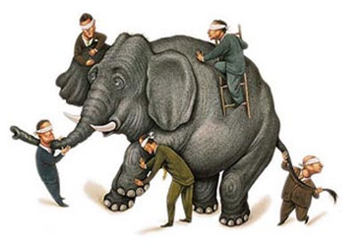

Slide 73
Simple First
Paradigm-Commitment
Abstraction Seggregation
Domain Relationship
Listening and Learning
Languages
Binary Dependency
Domain Language
Shared Under-standing
Eloquence
Patterns aren’t solutions
Weasel Word Removal

Slide 74
IM PARADIGMA BLEIBEN
Unabhängig von der Sprache
Und es verstehen

Slide 75
Objekte Funktionen

Slide 76
Sprachen
Polyglott
C#, F#, Prolog, Io, Haskell, Brainfuck, Python, Ruby, Javascript, Lisp, Smalltalk, C++, C, Java, Groovy, Scala, Clojure, Perl, R

Slide 77
Vielleicht ist deine ProgrammierSprache ungeeignet, um es genau so zu tun

Slide 78
https://github.com/cessor/refuctoring

Slide 79
private static TimeSpan Transform(this IEnumerable<int> digits) { int result = 0; var r = digits.ToList(); for (int j = 0; j < r.Count; j++) { int i = (int)Math.Pow(60, j / 2); int rTimesI = r[r.Count - j - 1] * i; result += (j % 2 == 1) ? rTimesI * 10 : rTimesI; } return TimeSpan.FromSeconds(result); }

Slide 80
private static TimeSpan Transform(this IEnumerable<int> digits) { var secondsPerUnit = new [] { 1,10,60,600,3600,36000 }; return digits .Reverse() .Zip(secondsPerUnit, (digit, unit) => digit * unit) .Sum() .Seconds(); }

Slide 81
Natürliche
Gesprochene,
Sprache

Slide 82
var date = new DateTime (2012, 4, 14, 16, 32, 18, 500);

Slide 83
var start = 14.April(2012).At(8.PM()); var end = 8.Hours().Later(start);

Slide 84
Sprachfertigkeit
Eloquenz
Eine Sprache richtig sprechen

Slide 85
Wenn du mir erklären kannst, was da passiert, wieso steht das da dann nicht?

Slide 86
[Test] public void ShouldConvertAnEvenNumberOfDigitsToATimespan() { // Arrange var bytes = new byte[] { 0, 0, 1,5, 0,5 }; var expected = new TimeSpan(0, 0, 15, 5, 0); // Act var actual = Transform(bytes); // Assert actual.Should().Equal(expected); }

Slide 87
When.IType(1, 5, 0, 5).And() .TransformTheDigits() .Then().TheResult().Should().Equal( 15.Minutes().And(5.Seconds()) );

Slide 88
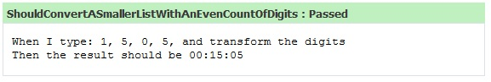

Slide 89
Simple First
Paradigm-Commitment
Abstraction Seggregation
Domain Relationship
Listening and Learning
Languages
Binary Dependency
Domain Language
Shared Under-standing
Eloquence
Patterns aren’t solutions
Weasel Word Removal

Slide 90
Abstraktion
Trennen von Einzelheiten
in Domäne und Maschine

Slide 91
for int i=0; GetCustomer

Slide 92
Exceptionell,
Ist etwas
Wenn du es erwartest?

Slide 93
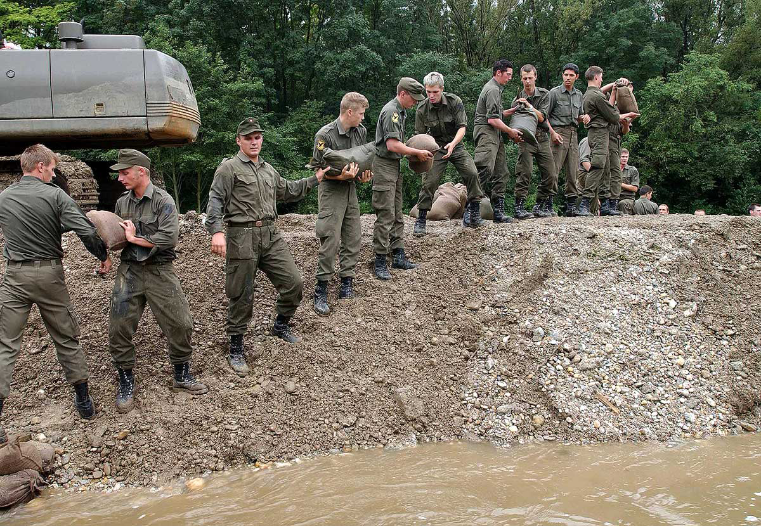

Slide 94
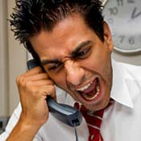
Complaints
Beschwerden
Wenn ein Problem besteht

Slide 95
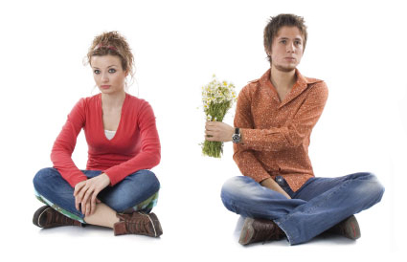
Apologies
Entschuldigung
Wenn es verzeihbar ist

Slide 96
Binäre Abhängigkeit
x = 1 + 2
Meist reicht das.

Slide 97
Dependent-on Components
Interactions
DATA

Slide 98
Event Based Components
EBC
Pins
Board

Slide 99
Imports Parameter Binäre Bäume

Slide 100
Entwurfsmuster
Design Patterns
Sind keine Lösung

Slide 101
Rather than “a general reusable solution to a commonly occurring problem”, I currently think of design patterns as a shared vocabulary for discussing the observable commonalities between two or more solutions, after they’ve emerged.

Slide 102
Rather than “a general reusable solution to a commonly occurring problem”, I currently think of design patterns as a shared vocabulary for discussing the observable commonalities between two or more solutions, after they’ve emerged.

Slide 103
Rather than “a general reusable solution to a commonly occurring problem”, I currently think of design patterns as a shared vocabulary for discussing the observable commonalities between two or more solutions, after they’ve emerged.

Slide 104
Rather than “a general reusable solution to a commonly occurring problem”, I currently think of design patterns as a shared vocabulary for discussing the observable commonalities between two or more solutions, after they’ve emerged.

Slide 105
Rather than “a general reusable solution to a commonly occurring problem”, I currently think of design patterns as a shared vocabulary for discussing the observable commonalities between two or more solutions, after they’ve emerged.

Slide 106
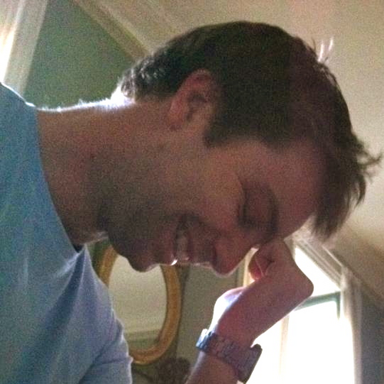
https://twitter.com/#!/jmrtn http://jmrtn.com/notes/2012/02/17/design-patterns.html

Slide 107
Simple First
Paradigm-Commitment
Abstraction Seggregation
Domain Relationship
Listening and Learning
Languages
Binary Dependency
Domain Language
Shared Under-standing
Eloquence
Patterns aren’t solutions
Weasel Word Removal

Slide 108
DomänenBEZUG
Wenn du darüber sprichst…
…ist es wahrscheinlich wichtig

Slide 109
Email Adressen sind keine Strings

Slide 110
TinY TYpes

Slide 111
Dinge müssen nicht können aber sie können sein

Slide 112
Email InvalidEmail

Slide 113
Polymorphismen Typen

Slide 114
Domänensprache
Ubiquitous Language
Gegen Babylonische Sprachverwirrung

Slide 115
Systemische Metapher Klare Namen

Slide 116
Simple First
Paradigm-Commitment
Abstraction Seggregation
Domain Relationship
Listening and Learning
Languages
Binary Dependency
Domain Language
Shared Under-standing
Eloquence
Patterns aren’t solutions
Weasel Word Removal

Slide 117
Running
Never Touch a
System

Slide 118
Running
Never Change a
System

Slide 119
Changing
Always run a
System

Slide 121
Blind men and the elephant John Godfrey Saxe

Slide 122
It was six men of Indostan To learning much inclined, Who went to see the Elephant (Though all of them were blind), That each by observation Might satisfy his mind.

Slide 123
The First approached the Elephant, And happening to fall Against his broad and sturdy side, At once began to bawl: "God bless me!—but the Elephant Is very like a wall!"

Slide 124
The Second, feeling of the tusk, Cried:"Ho!—what have we here So very round and smooth and sharp? To me 't is mighty clear This wonder of an Elephant Is very like a spear!"

Slide 125
The Third approached the animal, And happening to take The squirming trunk within his hands, Thus boldly up and spake: "I see," quoth he, "the Elephant Is very like a snake!"

Slide 126
The Fourth reached out his eager hand, And felt about the knee. "What most this wondrous beast is like Is mighty plain," quoth he; "'T is clear enough the Elephant Is very like a tree!"

Slide 127
The Fifth, who chanced to touch the ear, Said: "E'en the blindest man Can tell what this resembles most; Deny the fact who can, This marvel of an Elephant Is very like a fan!"

Slide 128
The Sixth no sooner had begun About the beast to grope, Than, seizing on the swinging tail That fell within his scope, "I see," quoth he, "the Elephant Is very like a rope!"

Slide 129
And so these men of Indostan Disputed loud and long, Each in his own opinion Exceeding stiff and strong, Though each was partly in the right, And all were in the wrong!

Slide 130
So, oft in theologic wars The disputants, I ween, Rail on in utter ignorance Of what each other mean, And prate about an Elephant Not one of them has seen!

Slide 131
Blue
Rgb,
0,183,255
Orange,
Rgb,
255,116,0
Green,
Rgb
0,219,0
Magenta,
#FF00FF
Light Gray,
Rgb, 191,191,191
Dark Gray,
Rgb,
64,64,64

Slide 132
The blind men and the elephant http://en.wikisource.org/wiki/The_poems_of_John_Godfrey_Saxe/The_Blind_Men_and_the_Elephant Elephant http://inquiry111westminster.wikispaces.com/Blind%20men%20and%20an%20elephant Inspired by and using the fonts suggested at http://www.labnol.org/software/tutorials/advice-select-best-fonts-for-powerpoint-presentation-slides/3355/ Duck Duck Duck http://geekandpoke.typepad.com/geekandpoke/2012/03/static-typing.html Rapist http://rasmussenanders.blogspot.de/2011/03/catholic-priests-raping-nuns.html Bundeswehr http://www.bmlv.gv.at/download_archiv/photos/inlandseinsatz/images/hochwasser_august_26.jpg Complaints http://wayne.usschesapeake.org/wp-content/uploads/2011/06/Shout.png Apologies http://www.5lovelanguages.com/learn-the-languages/the-five-languages-of-apology/ Signature Survey http://c2.com/doc/SignatureSurvey/

